Slide 1
Agenda
User Stories

Slide 2
Scrum Flow
Project Charter
Business case, high level project scope, major milestones, product vision
User Story Development
Story writing workshops
Product Roadmap and Release Plan
Product backlog grooming
Sprint Execution
Multiple iterations
Release Software
Deploy software to operational environment
Project Close

Slide 3
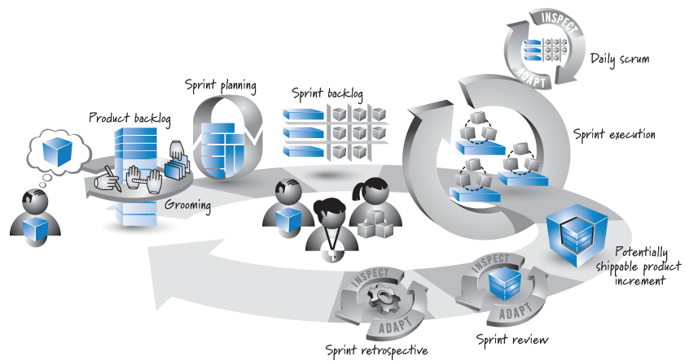
Scrum Framework
Source: Essential Scrum by Kenneth S. Rubin p. 17

Slide 4
User Story development

Slide 5
User Story Development
Story writing workshops
Team based approach for creating user stories
Product owner, developers, and other stakeholders meet to discuss and write user stories
Product owner drives the workshop and may serve as a proxy for the customer
Goal of the workshop is to create user stories for the product backlog
Items in the product backlog are called Product Backlog Items (PBIs)
Stories may be hierarchical and written at different levels of detail e.g. epic, theme, story

Slide 6
User Story Components
Specify a class of user (the user role), what that class of user wants to achieve (the goal), and the benefit expected as a result (the benefit)
Provide details for the story based on discussions with stakeholders, product owner and development team. This conversation is a critical component of the process.
Define the acceptance criteria
Source: Essential Scrum by Kenneth S. Rubin

Slide 7
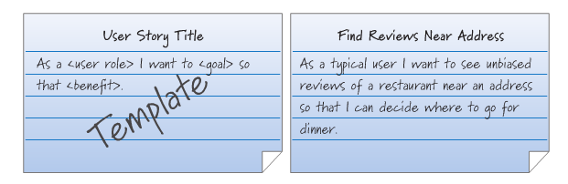
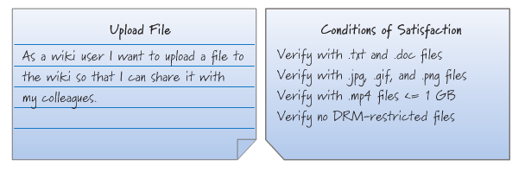
User Story Example
Source: Essential Scrum by Kenneth S. Rubin, page 83 and page 85

Slide 8
Story Writing Workshop
Identify and define users and user roles
Create personas for key user roles
For each user role, follow the template to write stories describing how they will use the system
For each user story, the product owner, developers and stakeholders discuss the user story to reach a shared understanding
Acceptance test criteria for each user story is created

Slide 9
Examples
Scrum Alliance Website

Slide 10
Exercise
Define the user roles for one a project discussed in a previous class
For each user role, define the following
Define the goal of the user when using the application
List two or three examples of common tasks performed by the user
Define the benefit of using the application

Slide 11
Additional User Story Comments
Stories should be independent from one another
Not always possible, but is a good goal
Allows development to occur in any order
Story details are negotiated between stakeholders with the the product owner having the final say
Avoid too much detail for each story as it can obscure the meaning of the story
Conversations are designed to capture the detail
User Stories Applied: For Agile Software Development by Mike Cohn

Slide 12
Which of the following are good user stories?
The user can run the system on desktop and mobile devices.
All graphing and charting will be done using Tableau.
The user can undo up to fifty commands.
The software will be released by June 30.
The software will be written in Java.
The user can select her country from a drop-down list.
The user will be prompted to save her work if she hasn't saved it for 15 minutes.
The user can export data to XML.
¹ Adapted from User Stories Applied: For Agile Software Development by Mike Cohn

Slide 13
Product Backlog
Prioritized list of product functionality
Provides shared understanding of what to build and is the heart of the scrum framework
Is composed of Product Backlog Items (PBIs)
PBIs may include new features, bug fixes, technical work, and knowledge acquisition
PBI Characteristics
Detailed appropriately, emerge over time, able to estimate, prioritized
Estimated using ideal days (ideal effort hours) or story points (size and complexity of story)
Grooming
The process of prioritizing, estimating, crafting and refining the product backlog
Flow management
Process of deciding how much to include in a sprint
Often categorized by “must have”, “nice to have” and “won’t have” features
Source: Essential Scrum by Kenneth S. Rubin

Slide 14
Requirements Management and Development
Elicitation
How will requirements be identified?
User interviews, surveys, competitor analysis, wireframe prototyping
Representation
How will requirements be documented?
User stories, use cases, prototypes, personas
Validation
How will requirements be validated?
Acceptance testing

Slide 15
Agile Development Management Tools
JIRA Software
https://www.atlassian.com/software/jira/demo
iRise (Elicitation)
iRise integration with Jira and Azure DevOps
VersionOne
https://community.versionone.com/VersionOne-Lifecycle/Lifecycle_Basics/Getting_Started_with_Lifecycle/Videos
Microsoft Azure DevOps

